Slide 1

Build an Android App – Week 3
Jon Douglas

Slide 2
Last Week Review
Did you complete week 2’s lab?
How did it go? Any issues?
Any questions from last lecture?
Remember what variables are and the different data types?
What are methods?
What method can we use to find views via code?

Slide 3
Week 2 Summary
We talked about nested viewgroups, how to take apart a view using a view hierarchy, and then we started learning some basics of programming such as variables and methods. We ended off last week with explanation of how to find views via code and setting up a Click listener.

Slide 4
We Learned…
- Adding button code to your app
- Updating views
- Properly scoping variables
- Finding views by their ID

Slide 5
Object Oriented Programming
Real-world objects share two characteristics: They all have state and behavior. Dogs have state (name, color, breed, hungry) and behavior (barking, fetching, wagging tail). Bicycles also have state (current gear, current pedal cadence, current speed) and behavior (changing gear, changing pedal cadence, applying brakes). Identifying the state and behavior for real-world objects is a great way to begin thinking in terms of object-oriented programming.

Slide 6


Public vs. Private

Slide 7
Defining a method (part 2)
{Access Modifier} {Return Data Type} {Method Name}({Parameter 1 Data Type} {Parameter 1 Variable Name})
- Access Modifier - Public/Private
- Return Data Type - void/int/String
- Method Name - Descriptive of what the method does
- Parameter Name - Descriptive of what the input is public int calculatePrice(int totalCost) { return totalCost * 5; }

Slide 8
Objects
SoccerPlayer
We can define objects that mimic real world things.
We can create classes that better describe a single object rather than many random variables
public class SoccerPlayer { // class name
int number; // variables
String name;
String position;
void run() { ...... } // methods
void kickBall() { ...... }
}
Name
Number
Position

Slide 9
Various things we can do with objects
Instantiate objects:
SoccerPlayer newPlayer = new SoccerPlayer();
Set variables:
newPlayer.name = “Jimmy”;
Call methods:
newPlayer.kickBall();
Notes:
CMD+OPTION+8 TO ZOOM

Slide 10
Accessing Resources through Code
- Image - R.drawable
- String - R.string
- Layout - R.layout
- ID - R.id
- Color - R.color
Notes:
CMD+OPTION+8 TO ZOOM

Slide 11
Defining Resources in XML
- Image - @drawable/
- String - @string/
- Layout - @layout/
- ID - @id/
- Color - @color/
Notes:
CMD+OPTION+8 TO ZOOM

Slide 12
Boolean data type
The boolean data type is a **true or false** data type. This data type is especially important for cases where you might need to ensure a condition is met before continuing.
Java:
boolean isQuestionCorrect = false;
C#:
bool isQuestionCorrect = false;
Notes:
CMD+OPTION+8 TO ZOOM

Slide 13
Why learn about different types?
In Android, we have many controls that can give us different values.
EX:
We define a `Checkbox` control which has a `Checked State` of either true or false. This can indicate to us that an option is selected or not.
Notes:
CMD+OPTION+8 TO ZOOM

Slide 14
Conditional Code
Conditionals are how we can make decisions in our applications. We can use language features such as `if / else` to create conditionals in our code.
Notes:
CMD+OPTION+8 TO ZOOM

Slide 15
If Statement
The if statement simply checks whether the condition is true or false.
EX:
if (isClassOver) {
//What code runs when class is over?
}
Notes:
CMD+OPTION+8 TO ZOOM

Slide 16
If/Else Statement
But what about if the statement does not meet the condition? We don't always want to execute code sometimes. We can use an if/else statement:
EX:
if (isClassOver) {
//What code runs when class is over?
} else {
//What code runs if class is not over?
}
Notes:
CMD+OPTION+8 TO ZOOM

Slide 17
If/Else If/Else Statement
What if we need to cover multiple conditions though? We can use an `else if` to match on conditions before the `else` hits.
EX:
if (isClassOver) {
//What code runs when class is over?
} else if (isClassOver && classStudents > 20) {
//What code runs if class is over and there's more than 20 students?
} else {
//What code runs if class is not over?
}
Notes:
CMD+OPTION+8 TO ZOOM

Slide 18
Equality and Relational Operators
== equal to
!= not equal to
> greater than
>= greater than or equal to
< less than
<= less than or equal to
Notes:
CMD+OPTION+8 TO ZOOM

Slide 19
Intents
An intent is a "Intention to hand off work to something else". For example, you might want to delegate some hard work to another application to handle.
EX:
You might want to take a picture in your application but you haven't coded a camera in your app. However you can send an intent for the Android OS to find an application that can take a picture for you.
Notes:
CMD+OPTION+8 TO ZOOM

Slide 20
What’s inside an Intent?
- Action
- Data / Data URI
- Category
- Component
- Extras
Notes:
CMD+OPTION+8 TO ZOOM

Slide 21
Using an Intent to pass data/extras
Intent i = new Intent(this, ActivityTwo.class);
i.putExtra("Value1", "This value one for ActivityTwo ");
i.putExtra("Value2", "This value two ActivityTwo");
As value you can use the primitive data types (int, float, …​) plus objects of type String, Bundle, Parcelable and Serializable.
Notes:
CMD+OPTION+8 TO ZOOM

Slide 22
Retrieving an Intent’s extras
Bundle extras = getIntent().getExtras();
if (extras == null) {
return;
}
// get data via the key
String value1 = extras.getString(Intent.EXTRA_TEXT);
if (value1 != null) {
// do something with the data
}
Notes:
CMD+OPTION+8 TO ZOOM

Slide 23
Quiz #1
Object Oriented program mocks real life examples of objects?
True
False
Notes:
CMD+OPTION+8 TO ZOOM

Slide 24
Quiz #1 - Answer
True
Notes:
CMD+OPTION+8 TO ZOOM

Slide 25
Quiz #2
How many arguments/parameters must a method have?
0 or more
1 or more
2 or more
Notes:
CMD+OPTION+8 TO ZOOM

Slide 26
Quiz #2 - Answer
0 or more
Notes:
CMD+OPTION+8 TO ZOOM

Slide 27
Quiz #3
The boolean data type returns a value of true or false?
True
False
**Note:** Yes this is a confusing question, I'm asking if it returns either true or false.
Notes:
CMD+OPTION+8 TO ZOOM

Slide 28
Quiz #3 - Answer
It can return either true or false
Notes:
CMD+OPTION+8 TO ZOOM

Slide 29
Quiz #4
What is the equality operator for not equal to?
- ==
- !=
- not =
- <=
Notes:
CMD+OPTION+8 TO ZOOM

Slide 30
Quiz #4 - Answer
!=
Notes:
CMD+OPTION+8 TO ZOOM

Slide 31
Quiz #5
What is an intent useful for?
- Delegating work
- Communicating with another app
- Sending extra information
- All of the above
Notes:
CMD+OPTION+8 TO ZOOM

Slide 32
Quiz #5 - Answer
All of the above
Notes:
CMD+OPTION+8 TO ZOOM

Slide 33
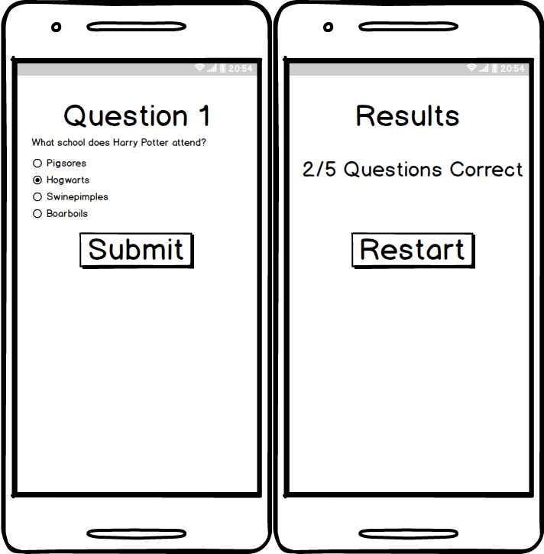
App #3 – Quiz App
Design and implement a quiz app of your favorite trivia questions
Notes:
CMD+OPTION+8 TO ZOOM

